Slide 1
Algorithmic Development for Reconstructing Surface Ocean pCO₂
Using Shapely values to interpret & evaluate earth models
Arnav Saxena, Bowen Han, George Lu, Mujahed Darwaza

Slide 2
Motivation
The ultimate goal of earth model reconstructions is to most accurately reflect the real world and its physics because any departure from real world physics will result in inaccuracies and improbable outcomes in downstream tasks
By knowing any irregularities in the reconstruction models before hand, researchers can potentially avoid such faulty scenarios

Slide 3
What are Shapley Values?
Predict number of ice-cream cones sold in an airport on a given day
Features = [temp, num_flights]
Avg. prediction across dataset = 1000 cones
Prediction for an instance [temp=2 deg celsius, num_flights=1000 flights]=400
Then shapley values quantify how much does each feature value [2 deg celsius,1000 flights] contributed in the difference of avg prediction across data set and prediction for this particular instance (400-1000= -600)
Calculated using SHapley Additive exPlanations or SHAP algorithm
https://www.youtube.com/watch?v=NBg7YirBTN8&t=11s

Slide 4
Outline
Explaining ML model ~ Explaining earth system on which it has been trained
Identify which features are most important in these model reconstructions
Identify trends in these features to make sure that these model reconstructions make physical sense

Slide 5
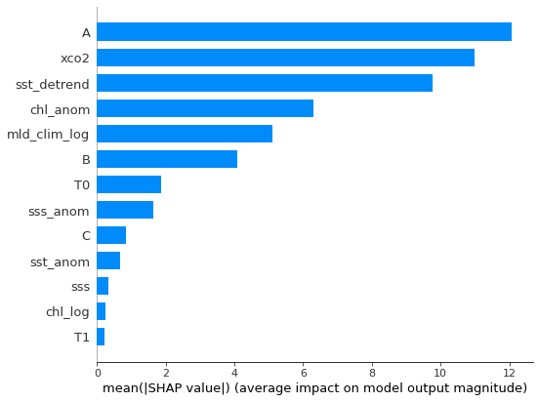
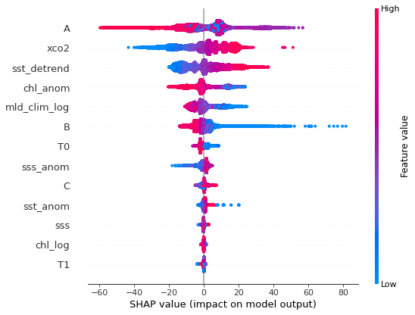
Shapely Values: Identifying important features
*A = sin(latitude), B= sin(longitude)xcos(latitude), C=cos(longitude)xcos(latitude)

Slide 6
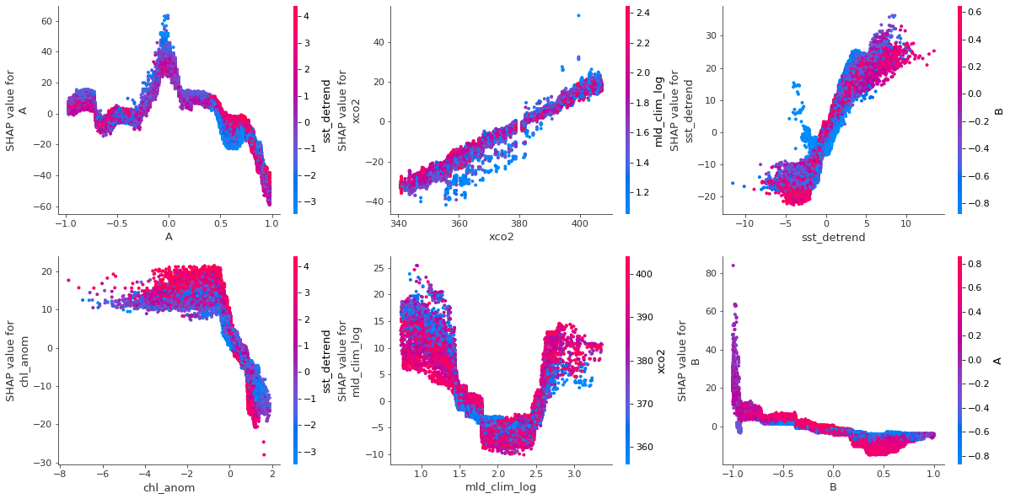
Investigating feature interactions
Notes:
Instances with lower chl anom + lower sst detrend values have lower contribution to model prediction as compared to those with lower chl + higher sst.

Slide 7
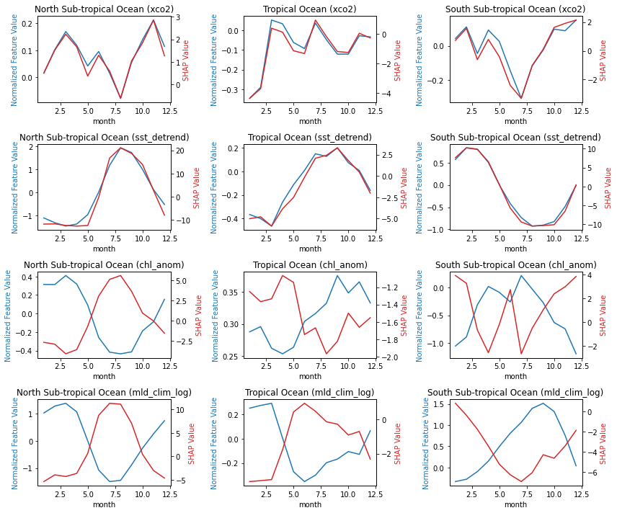
Do these seasonal trends in features make sense?

Slide 8
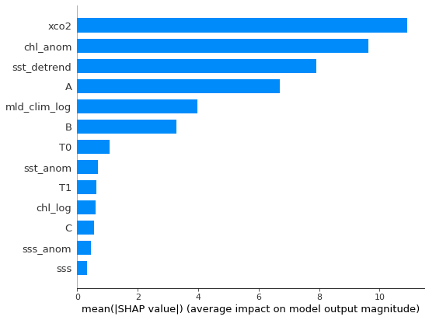
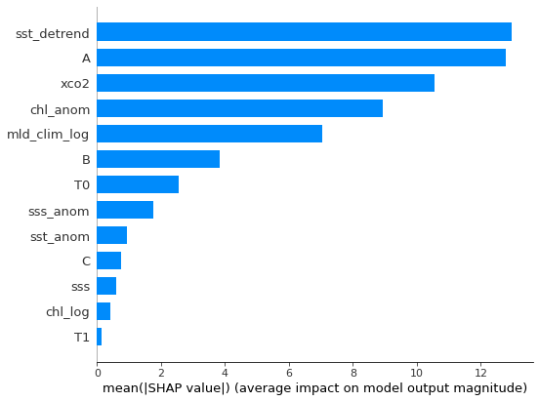
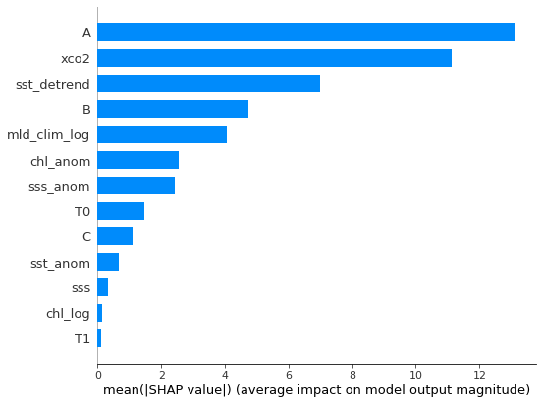
Looking at importance in each region
South Sub-tropical
North Sub-tropical
Tropical

Slide 9
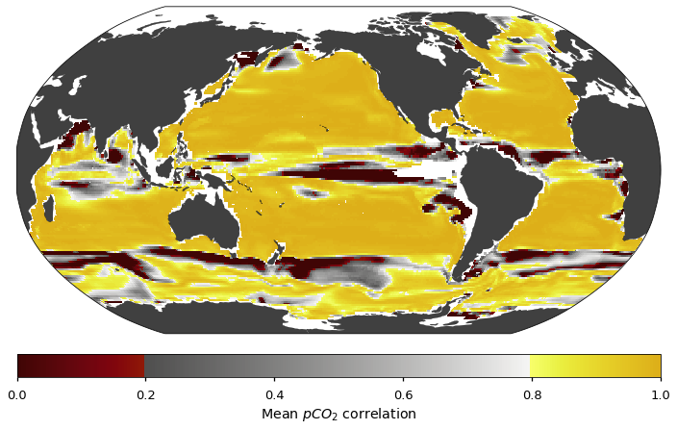
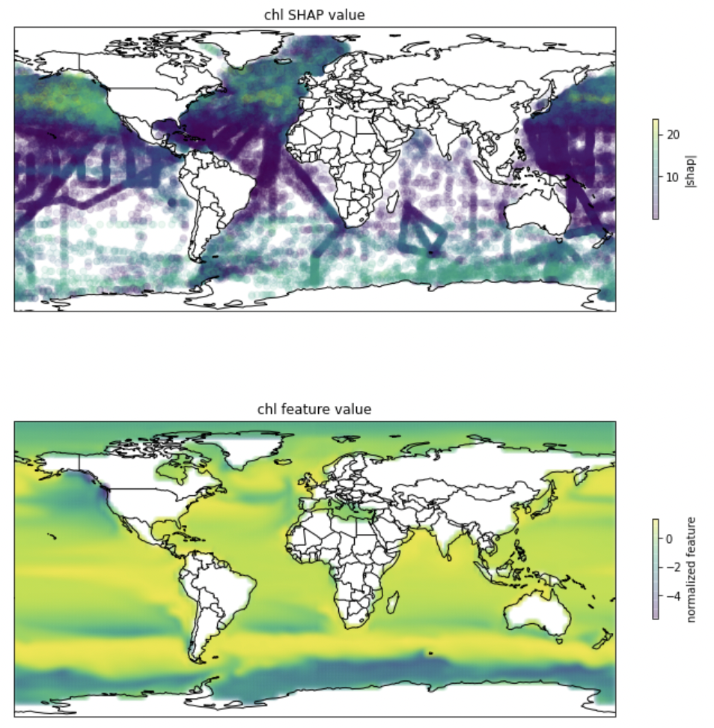
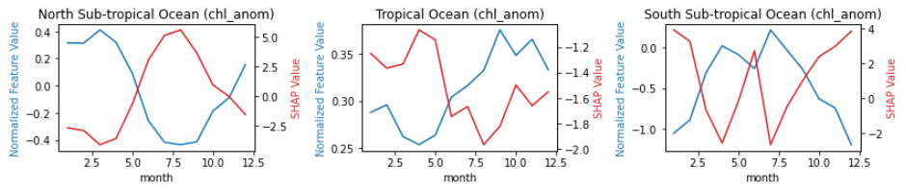
Mean pCO2 correlation (evaluating seasonality capture)

Slide 10
Discussion
Tested on other members, models
Identified important features: co2 mixing ratio, chlorophyll anomaly, SST, mixed layer depth
Validated seasonal trends in temperature, biological activity, and mixed layer depth in subtropics
Identified potential mismatch between biological activity trends in Southern ocean and its importance in pCO2 reconstruction
Next steps: test on more members/models, real world data

Slide 11
Appendix

Slide 12
